Slide 1

Morphology and Word Formation in Natural Languages DSA0307-Natural Language Processing
Guided By:
Dr. Anbazhagan K
Presented By:
C. Ishwarya (192472108)

Slide 2
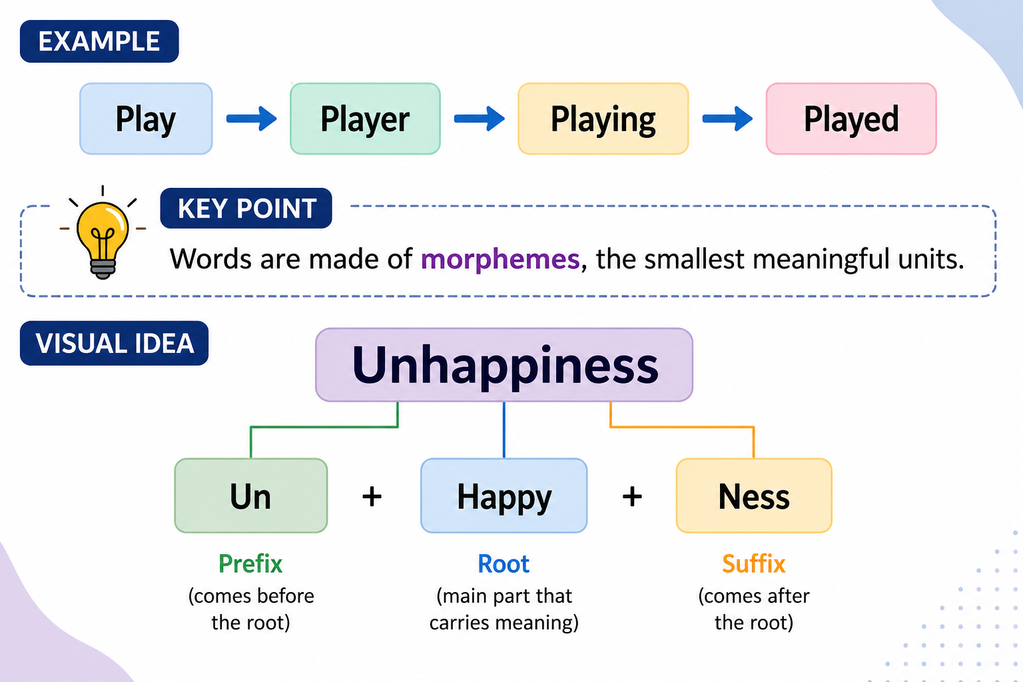
What is Morphology?
Morphology is the study of the internal structure of words.
It explains how words are formed and how they change meaning.
In NLP, morphology helps computers understand different forms of a word.

Slide 3
Types of morphology
INFLECTIONAL MORPHOLOGY
DERIVATIONAL MORPHOLOGY
Inflectional morphology changes the grammatical form of a word without changing its basic meaning or word class (part of speech).
Example
Play → Played
The meaning is still play, only the tense changes
Derivational morphology creates a new word by adding prefixes or suffixes. It often changes the meaning and sometimes the part of speech.
Example
Teach (Verb)
↓
Teacher (Noun)
A completely new word is formed.

Slide 4
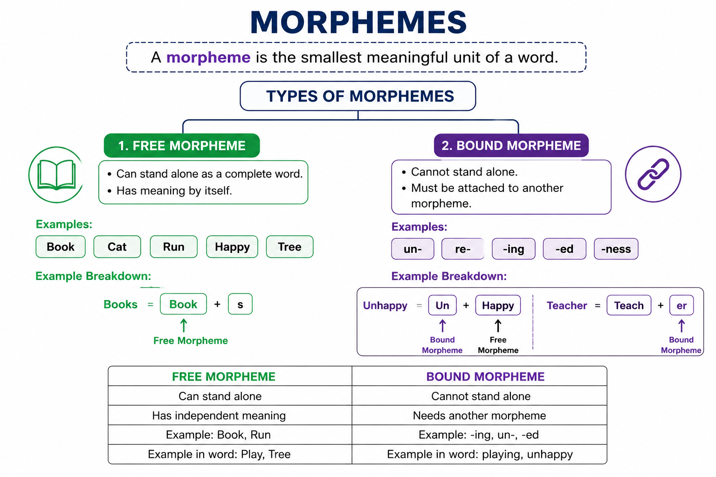

Slide 5
WORD FORMATION PROCESSES
Process | Meaning | Example
Prefixation | Add a prefix | Happy → Unhappy
Suffixation | Add a suffix | Teach → Teacher
Compounding | Join two words | Tooth + Brush = Toothbrush
Blending | Merge parts of words | Smoke + Fog = Smog
Clipping | Shorten a word | Advertisement → Ad
Acronym | Initial letters form a word | NASA

Slide 6
Why Morphology is Important
Improves machine translation
Helps search engines
Supports spell checking
Used in chatbots
Text classification
Information retrieval
Real-World Applications
Google Search
Grammarly
ChatGPT
Voice Assistants
Machine Translation
Text Summarization
Sentiment Analysis

Slide 7
CONCLUSION
Morphology studies word structure. Morphemes are the smallest meaningful units.
Words are formed using different processes.
Morphology improves NLP systems by understanding word variations.
It plays a key role in AI-based language technologies.

Slide 8


